Slide 1


Veer Narmad South Gujarat University
TOPIC:
INDIAN RAILWAY
MIHIR JAYESHKUMAR MEHTA
SEAT NO:
1468
NIDHI SOLANKI

Slide 2
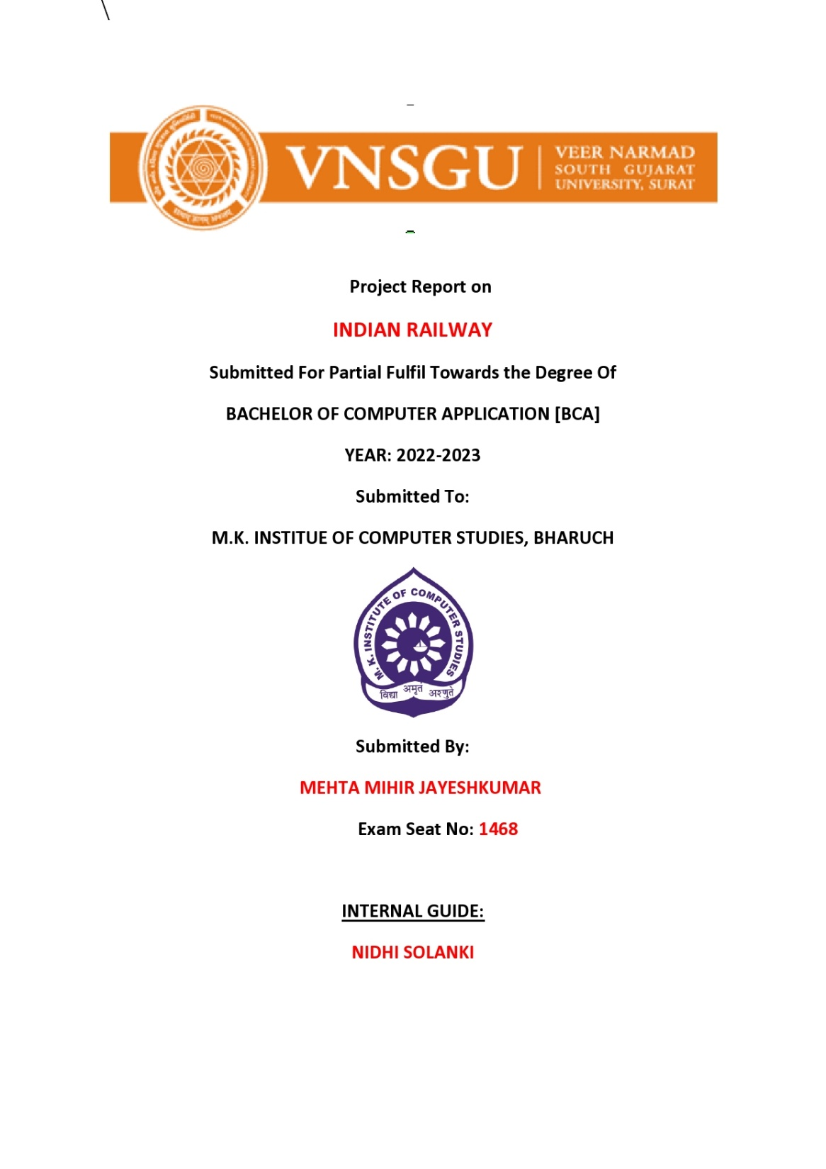

Slide 3
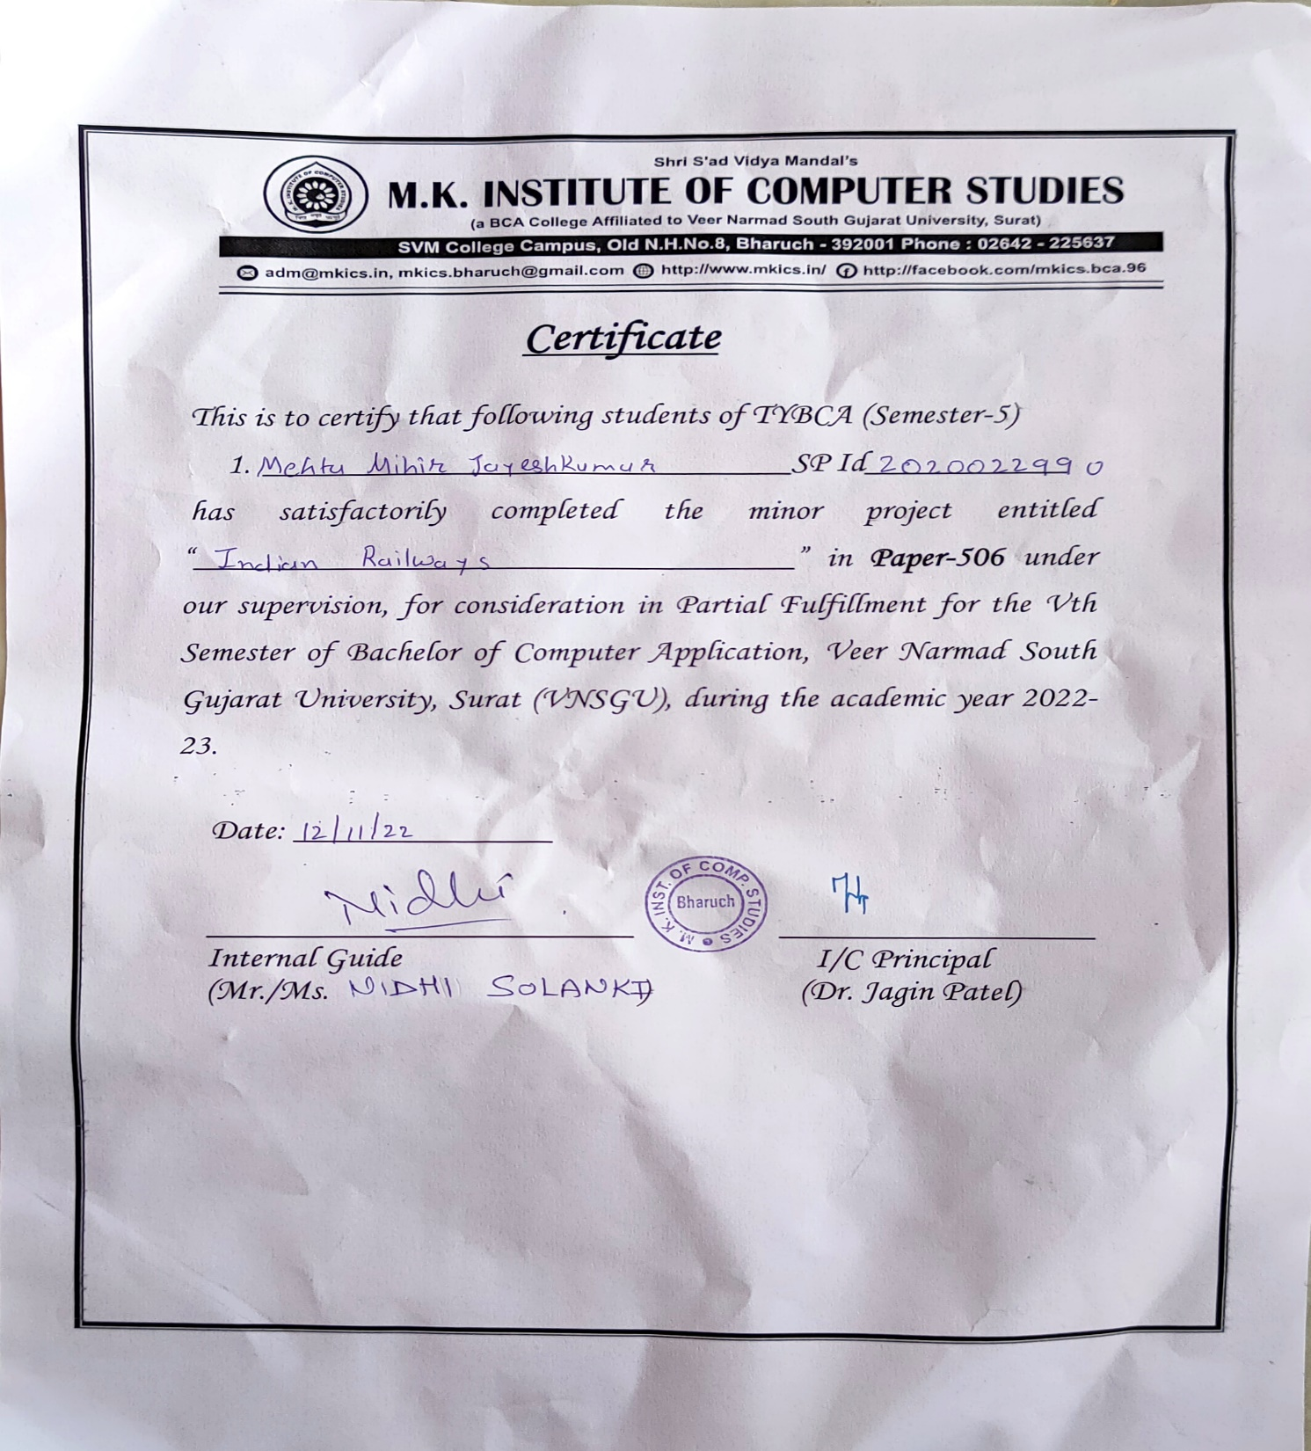

Slide 4
ABSTRACT
The Indian Railways (IR) carries about 5.5 lakhs passengers in reserved accommodation every day. The Computerised Passenger Reservation System (PRS) facilates the booking and cancellation of tickets from any of the 4000 terminals (i.e. PRS booking window all over the countries). These tickets can be booked or cancelled for journeys commencing in any part of India and ending in any other part, with travel time as long as 72hours and distance upto several thousand kilometres
In the given project we will be developing a website which will help users to find train details, book and cancel tickets and the exact rates of their tickets to the desired destination

Slide 5
With the help of online booking people can book their tickets online through internet, sitting in their home by a single click of mouse. Using their credit cards people can easily get their tickets done within minutes.

Slide 6
INDEX
Sr.no | Title | Pg.no.
1 | INTREODUCTION General Overview……………… Survey ………………… | 4-5
2 | Objectives | 6
3 | Software, Tools and Technologies: | 6
4 | Software Requirements Specification Development Environments Operating environment: | 7
5 | Data Flow Diagram (DFD) Level 0 DFD……………… Level 1 DFD……………… Level 2 DFD…………….. | 8 - 11
6 | Screenshots | 12 - 17
7 | Summary and Conclusions Summary of Achievements Main difficulties encountered | 18

Slide 7
INTRODUCTION
General Overview
Our website has various kinds of information that helps regarding booking of tickets via railways.
Users will be able to search the train availability, the exact fare the arrival and departure time of the train and they can also book the ticket by using the debit, credit or master card and after booking the ticket if the user want to cancel it then they can easily do it also.

Slide 8
Survey
Our website has various kinds of information that helps regarding booking of tickets via railways.
Users will be able to search the train availability, the exact fare the arrival and departure time of the train and they can also book the ticket by using the debit, credit or master card and after booking the ticket if the user want to cancel it then they can easily do it also.
The number of the reservation counters available to the passengers and customers are very less.
On most of the reservation systems there are long queues, so it takes a long time for any individual to book the ticket.
As now there are no call centers facilities available to solve the queries of the passengers.

Slide 9
The online railway ticket reservation system aims to develop a web application which aims at providing trains details, trains availability, as well as the facility to book ticket in online for customers. So, we thought of developing a web based application which would provide the users all these facilities from his terminal only as well as help them in booking their tickets. The Application was to be divided into two parts namely the user part, and the administrator part. And each of these has their corresponding features. We decided to give the name of the website “ONLINE RAILWAY TICKET RESEVATION”. The online railway ticket reservation system is developed using PHP with C# as the backend in the .NET Framework

Slide 10
Organization of the report
Serial No. | Topic
1. | ABSTRACT
2. | INTRODUCTION
 | General Overview
 | Survey
3 | Objectives
3. | Software, Tools and Technologies:
4. | Data Flow Diagram (DFD)
 | Level 0 DFD
 | Level 1 DFD
 | Level 2 DFD
4. | Screenshots
5. | Summary and Conclusions
 | Summary of Achievements

Slide 11
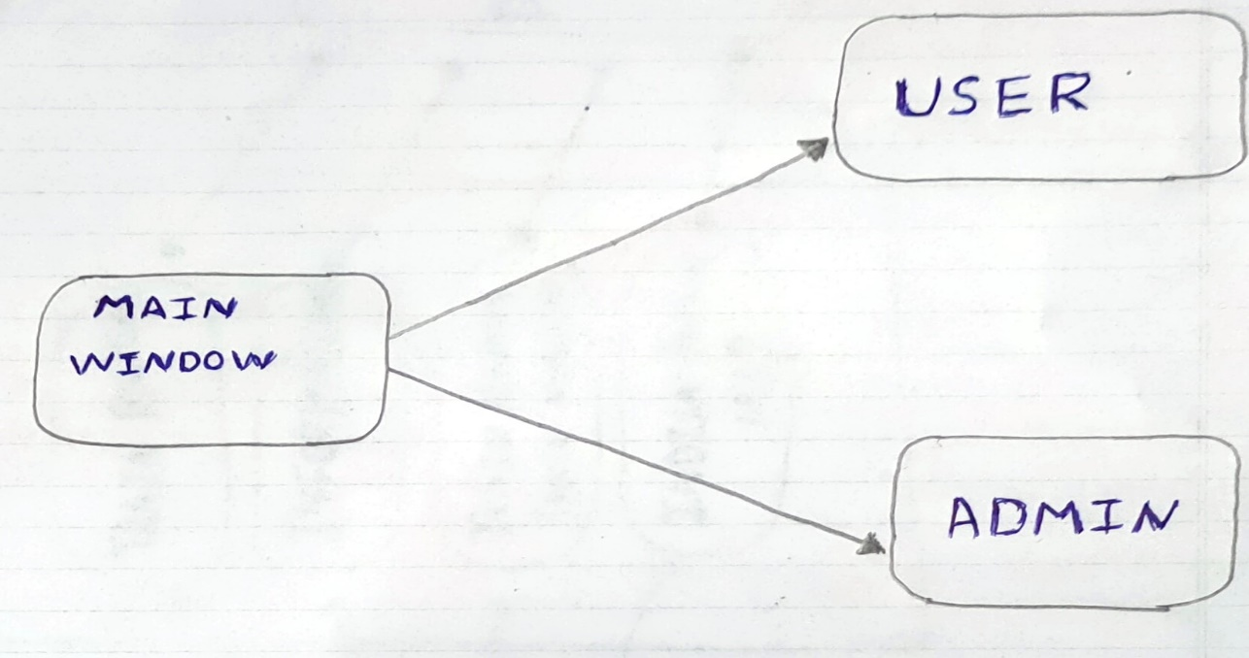
Data Flow Diagram (DFD)

Slide 12
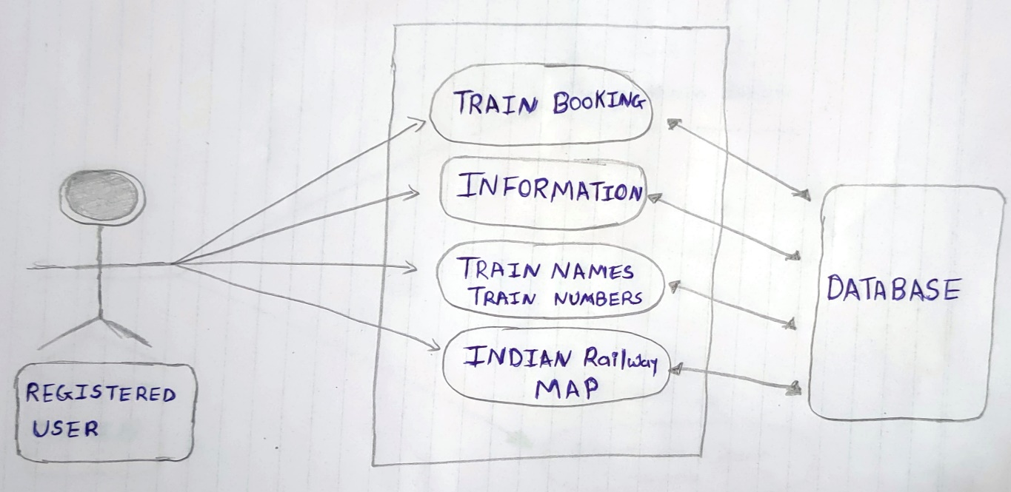
Fig: Homepage

Slide 13
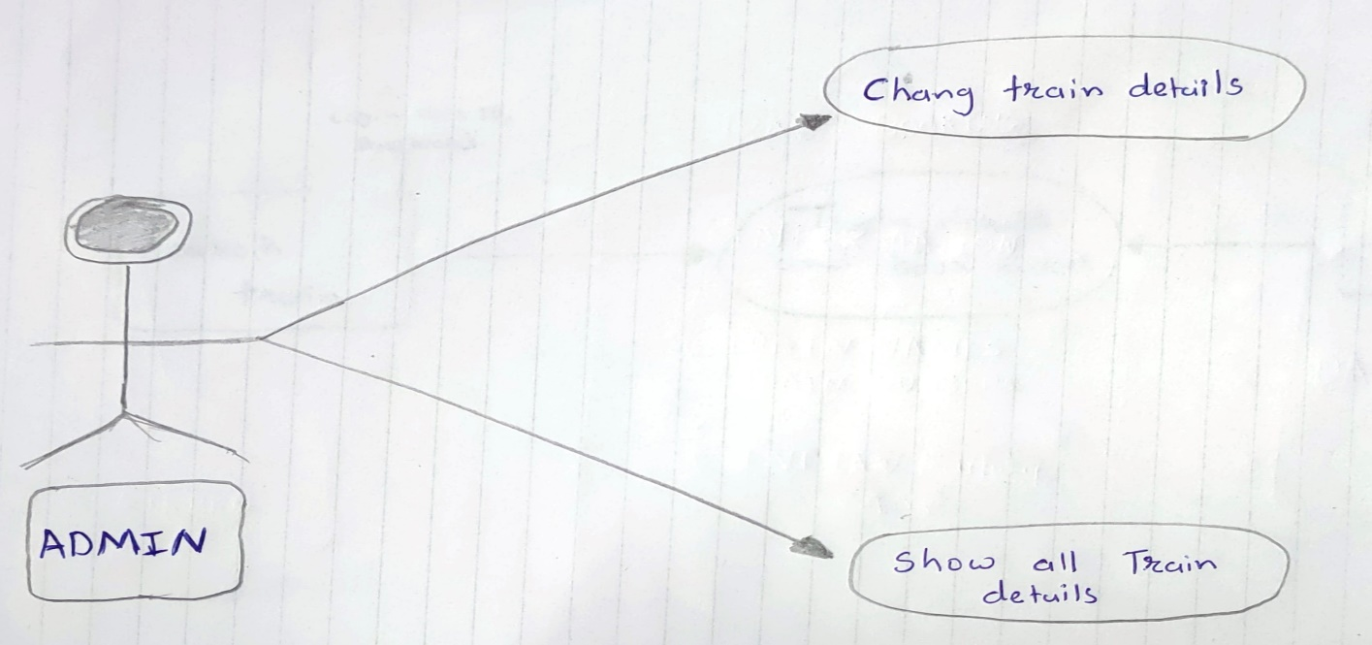

Slide 14
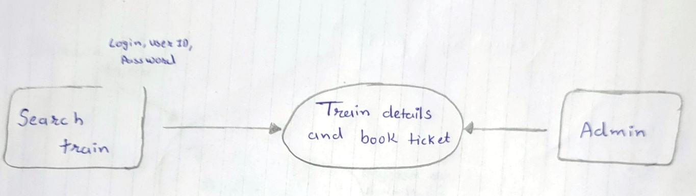
Data Flow Diagram
Level 0:
CONTEXT DIAGRAM

Slide 15
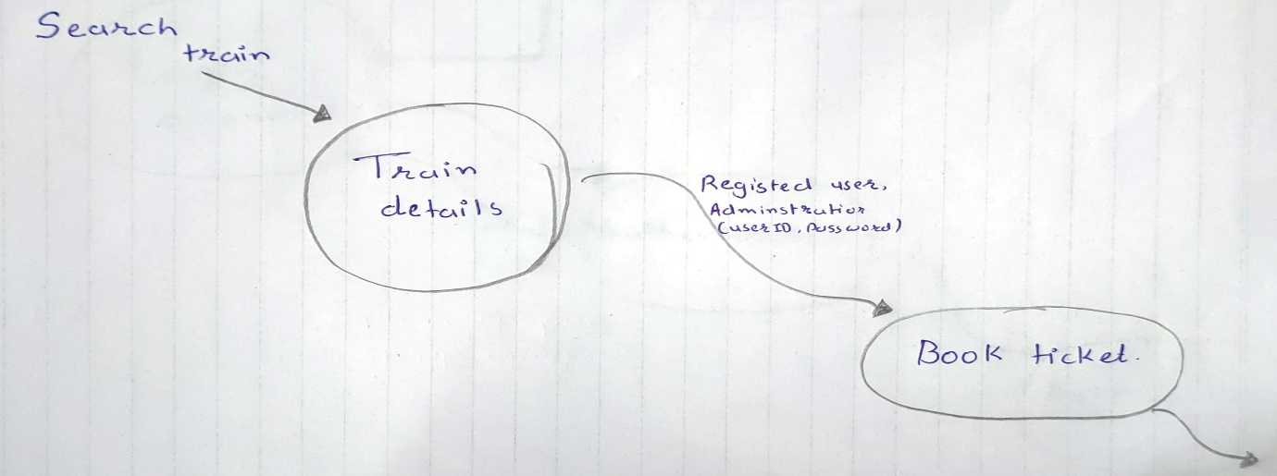
Level 1 DFD

Slide 16
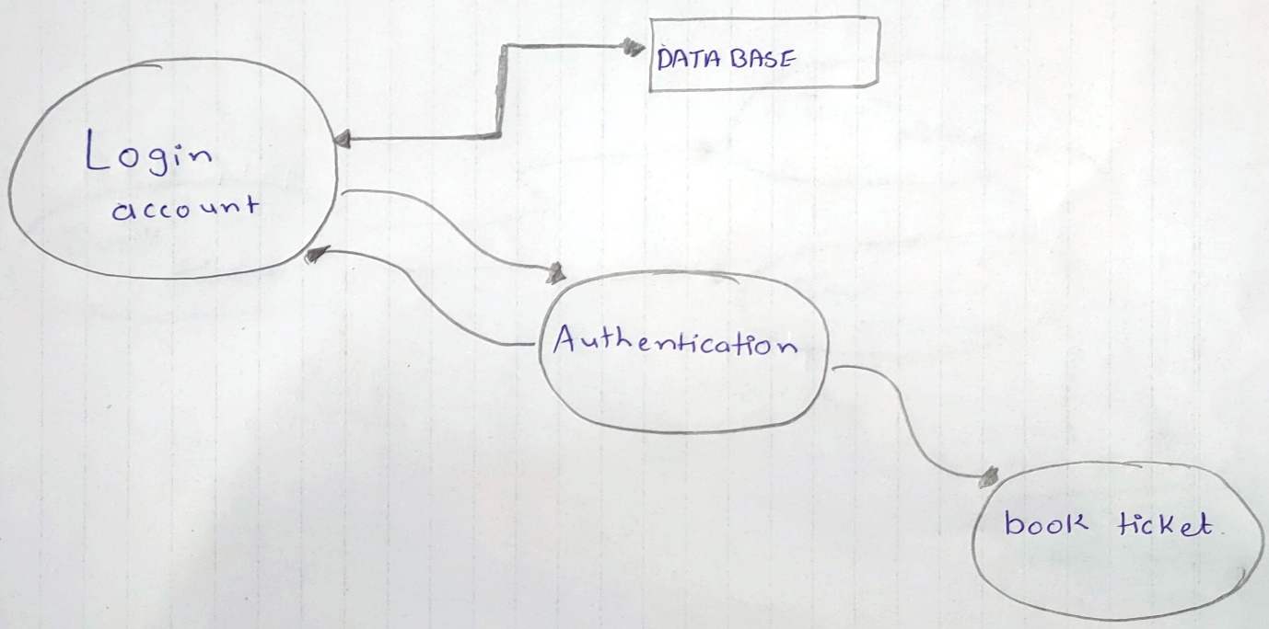
Level 2 DFD
For (Registered user)

Slide 17
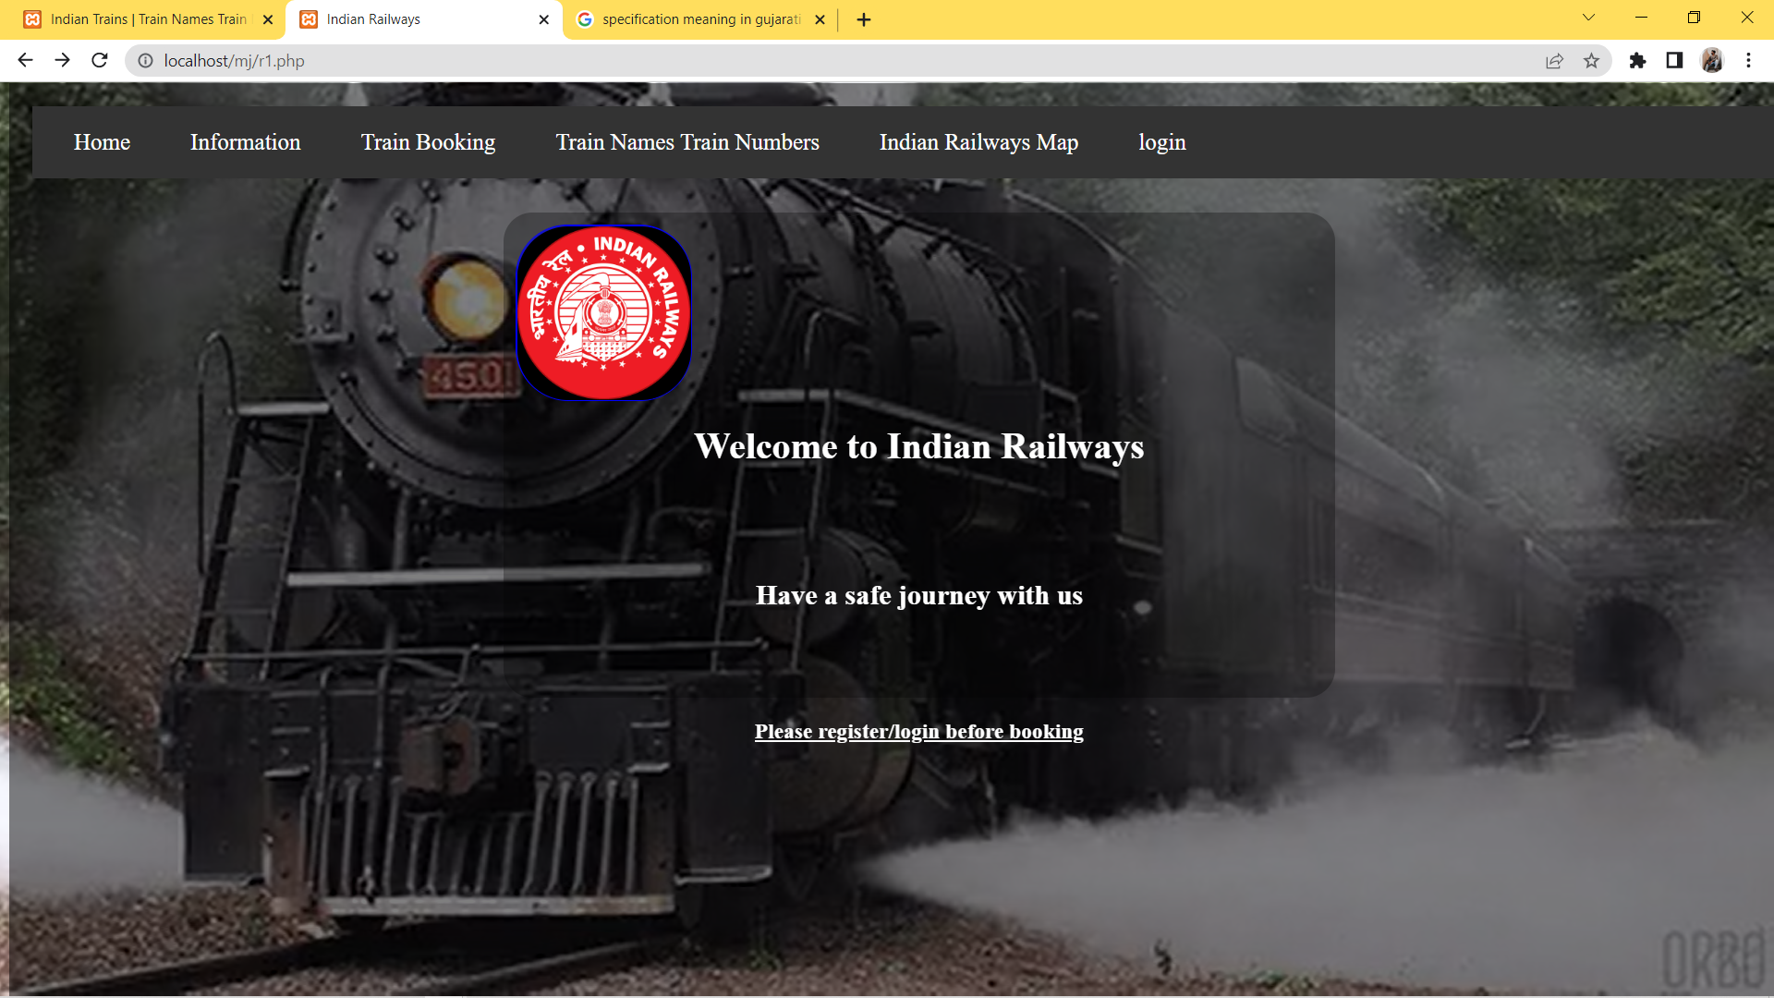
Screenshots
Home Page
The homepage or home page is the name of the main page of a website where visitors can find hyperlinks to other pages on the site. By default, the homepage on all web servers is index.

Slide 18
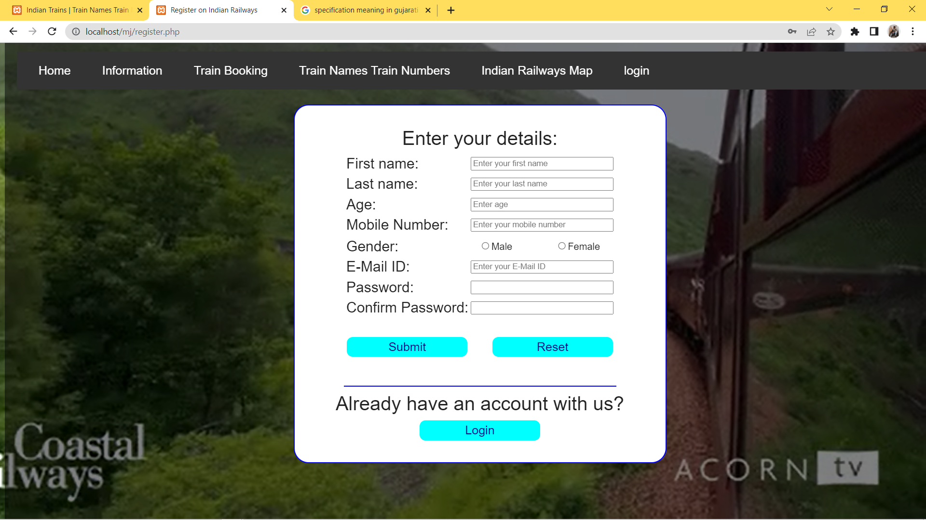
Register Page
A signup page enables users and organizations to independently register and gain access to your system. It is common to have multiple signup pages depending on the types of people and organizations you want to register.

Slide 19
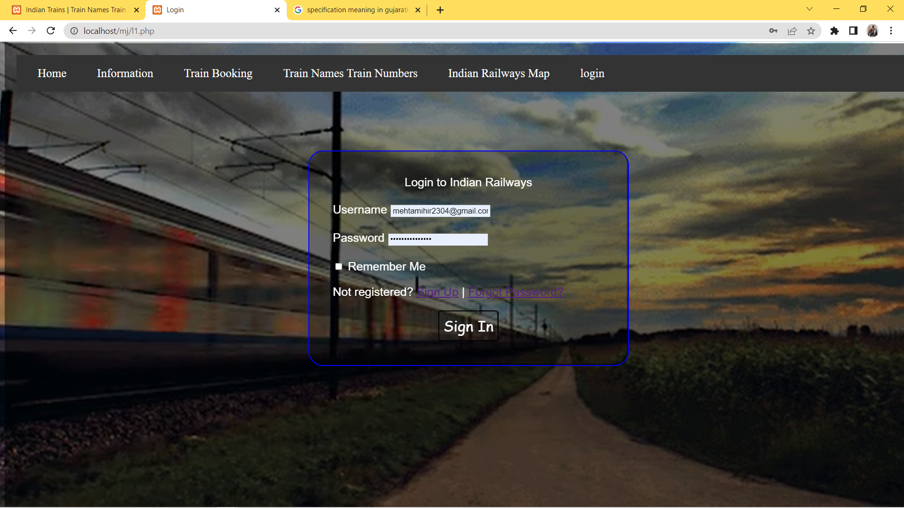
Login page
The login page allows a user to gain access to an application by entering their username and password or by authenticating using a social media login.

Slide 20
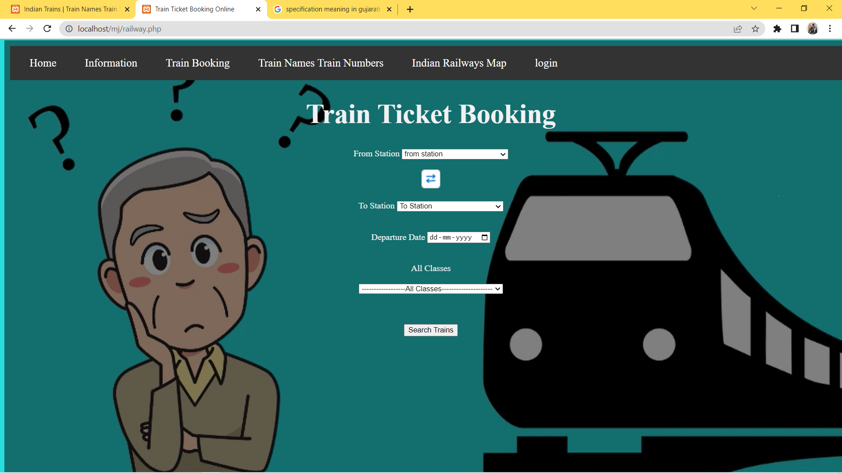
Ticket Booking
For booking a train ticket through Indian Railways booking counter, you have to visit the nearest railway station and ask for the reservation form. Fill the passenger details (Like: Name/s, age, gender, berth preference)

Slide 21
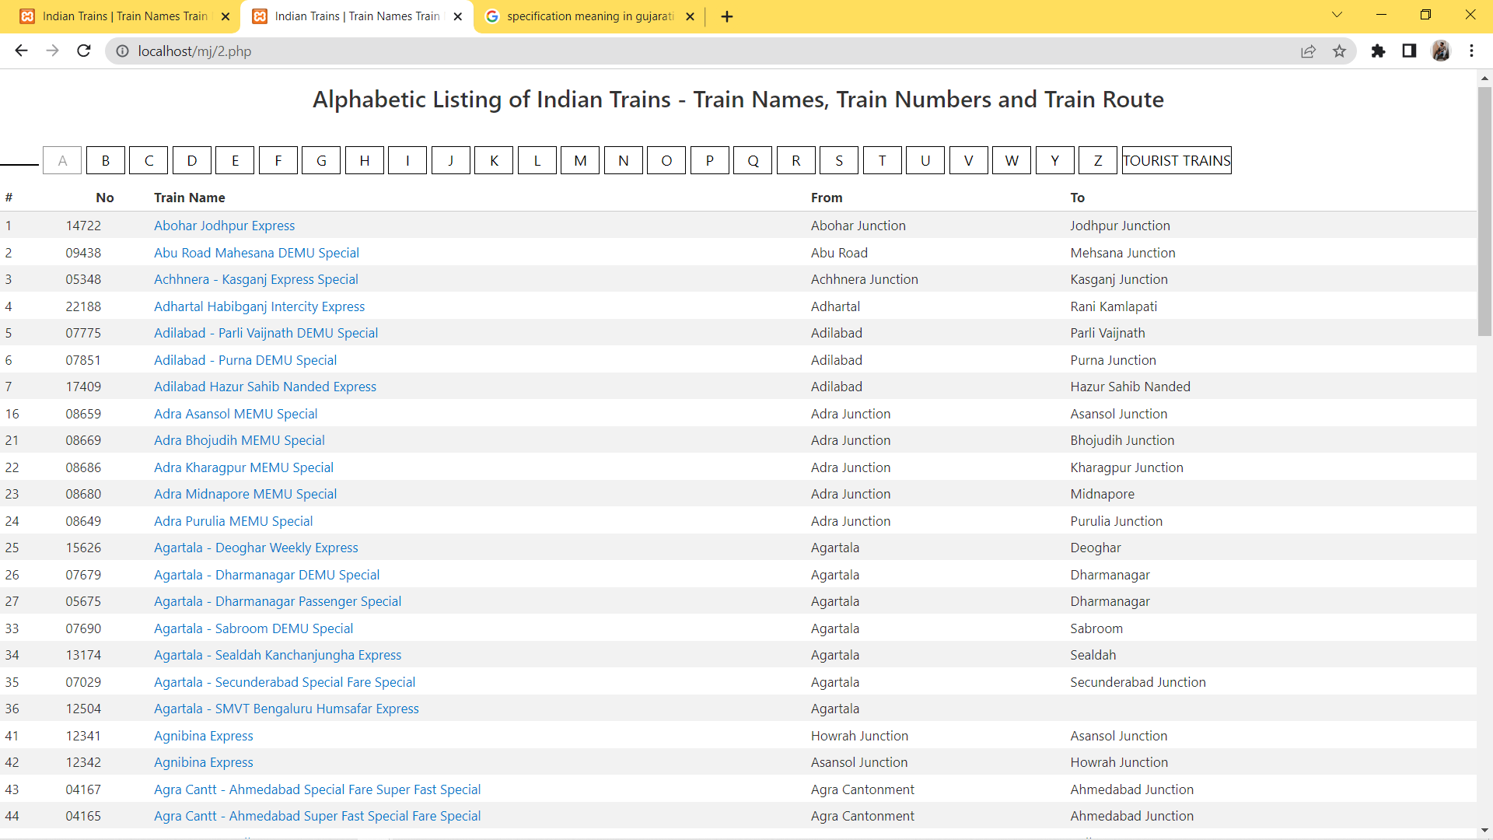
Train Names Train Numbers

Slide 22
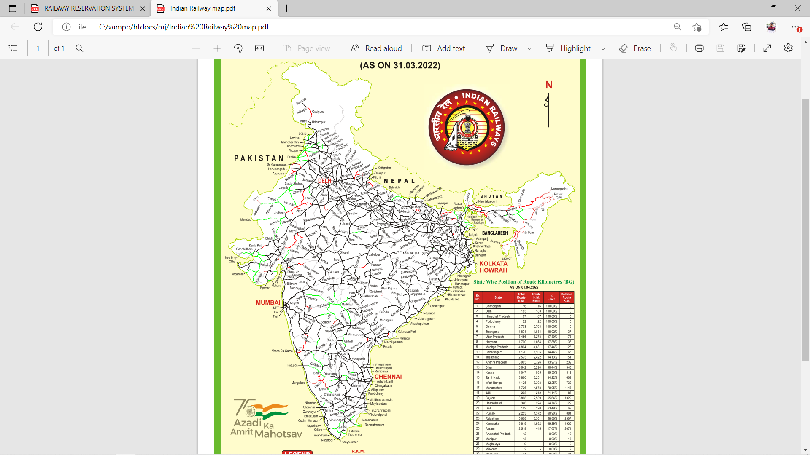
Indian Railway Map
In the mathematical subject of geometric group theory, a train track map is a continuous map f from a finite connected graph to itself which is a homotopy equivalence and which has particularly nice cancellation properties with respect to iterations.

Slide 23
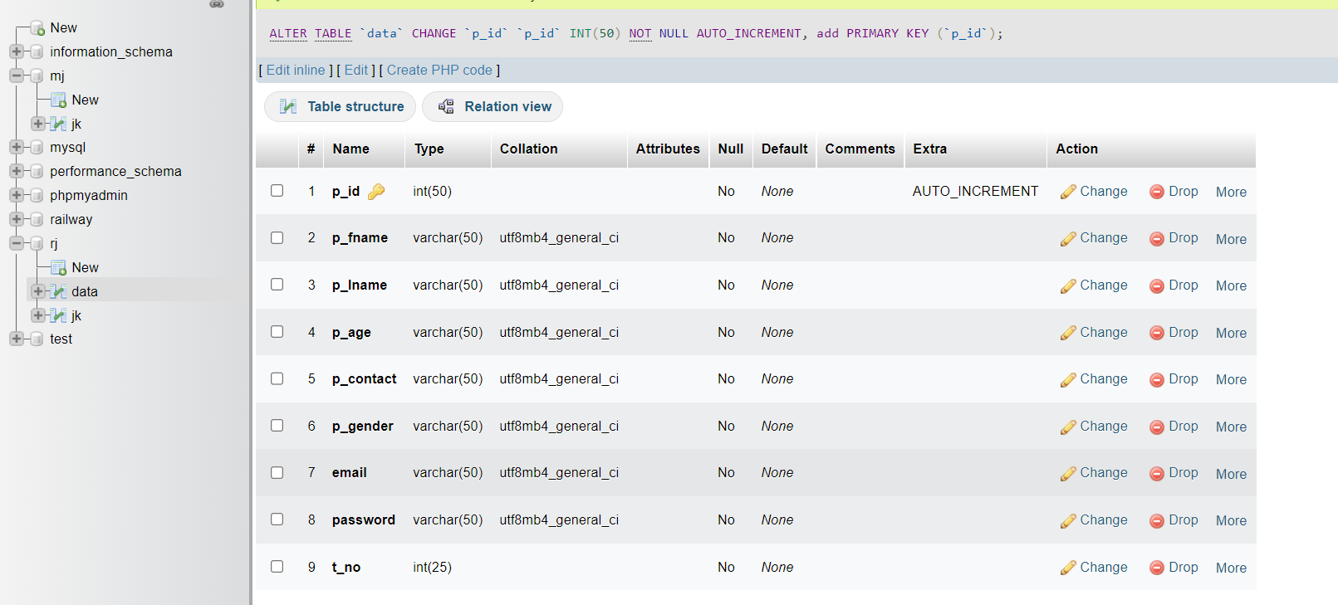
MYSQL
MySQL is a database management system. It may be anything from a simple shopping list to a picture gallery or the vast amounts of information in a corporate network. To add, access, and process data stored in a computer database, you need a database management system such as MySQL Server.

Slide 24
Summary and Conclusions
Summary of Achievements
The following achievements were made during the project:
• We had the opportunity to learn a new technology PHP
• Learned to work in visual studio 2010
• We learned to handle a project efficiently and correctly.
• Learned to tackle various adverse situations while managing and developing software.
• Learning about the functioning of the IT industry and work ethics in the corporate world.
• Learning to work with C#.NET and MS SQL Server 2005.
• Learning about the different phases of software development and the software engineering processes involved in the development of software.

Slide 25
Main difficulties encountered
• The main difficulty that was encountered during this project was that we had to learn a new PHP as well as a new language C# with which we were not at all familiar with earlier
• Time constraint.
• Learning the use of triggers.

